Slide 1
An introduction to the BBC Micro:bit
DHS SHICC
Link to slides: tinyurl.com/DHSmicrobit

Slide 2
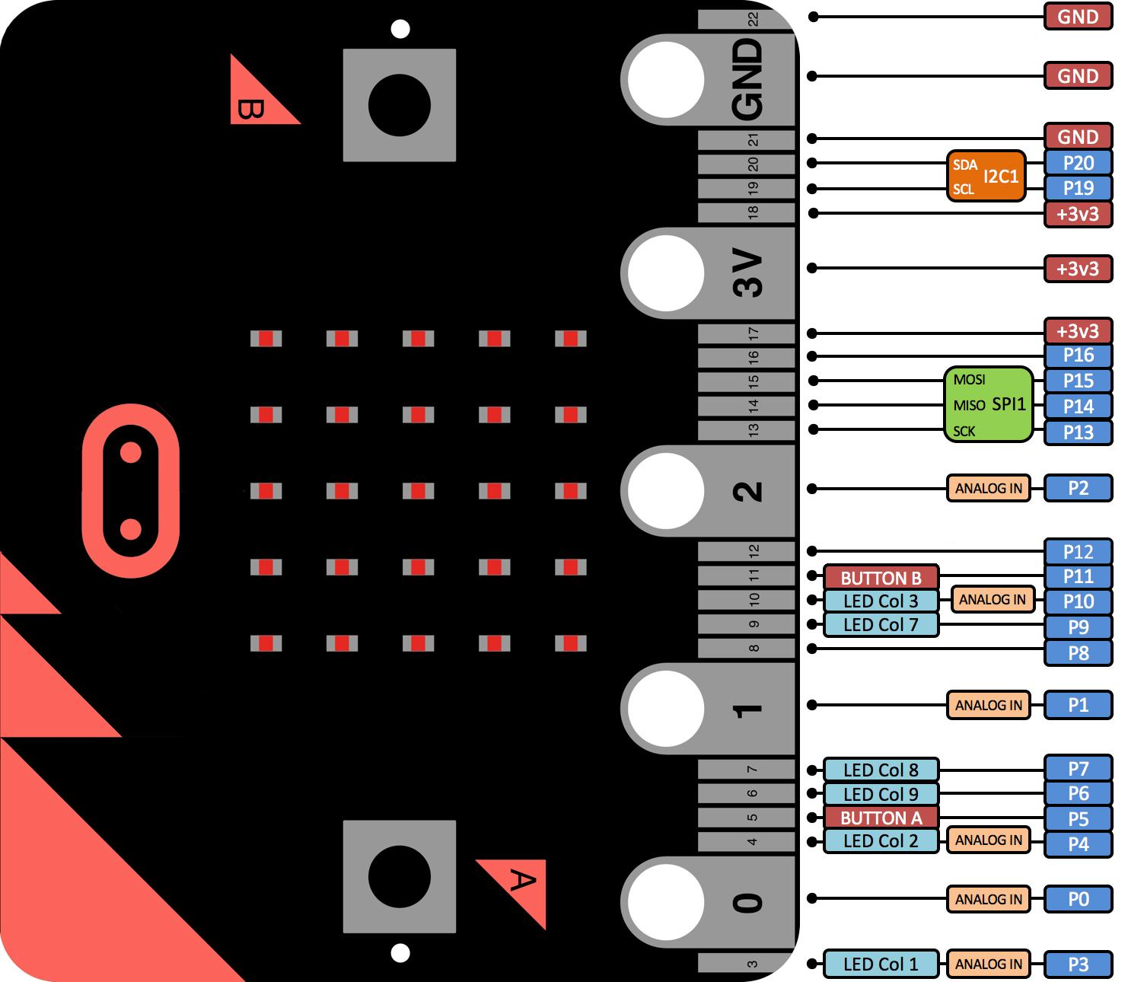
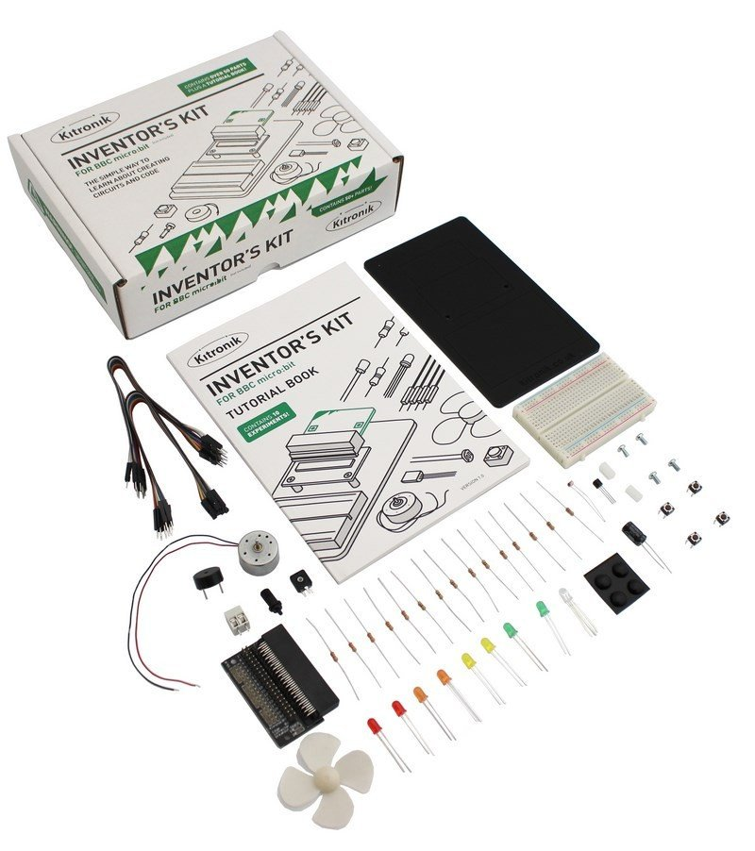
Inventor’s Kit
Notes:
(“Hey guys cheer up! “)
Today you will be learning something so useful that you may change the world someday! Or simply inspired by me. What we will be doing…. is an introductory course on BBC microbit.
Before we start, let’s check you have everything we are going to need for this course. You should have a laptop which should be connected to the internet and the inventors’ kit.
During the course, we will be using this slide as a guide. You can access this slide using the link. If at any point in time, you guys have any questions or you are stuck. You can feel free to ask me or approach the student helpers at the side of the room.
Is everyone on this slides?

Slide 3
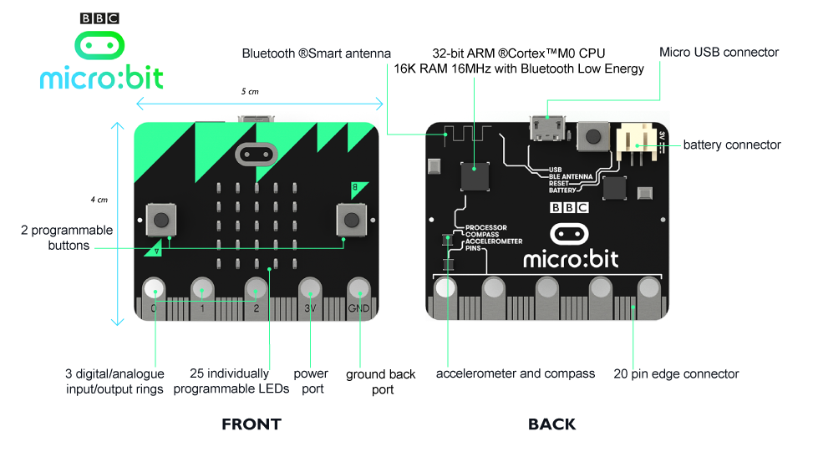
What is the BBC Microbit?
http://www.microbit.org
Pocket size codable computer
  Motion detection
  Built-in compass
  Bluetooth connection
Aim: inspire young people to get creative with digital environments and develop core skills in science, technology and engineering.
Notes:
The BBC micro:bit is a pocket-sized codeable computer with motion detection, a built-in compass and Bluetooth connectivity, which is given free to every child in year 7 or equivalent across the UK. It aims to inspire young people to get creative with digital environments and develop core skills in science, technology and engineering.
Easy to learn n can make some cool projects with it.
A display consisting of 25 red LEDs;
Two programmable buttons;
An on-board motion sensor or “accelerometer”;
measure the rate of tilting
A built-in compass or “magnetometer”;
Bluetooth Smart Technology;
Three input and output (I/O) rings

Slide 4
Why the BBC Micro:bit?
More complex projects
http://www.bbc.com/news/technology-35824446
Where to get one:
https://shop.pimoroni.com/collections/micro-bit-uk

Slide 5
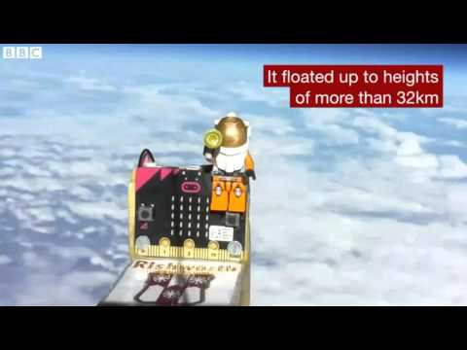
Notes:
Rishworth school

Slide 6
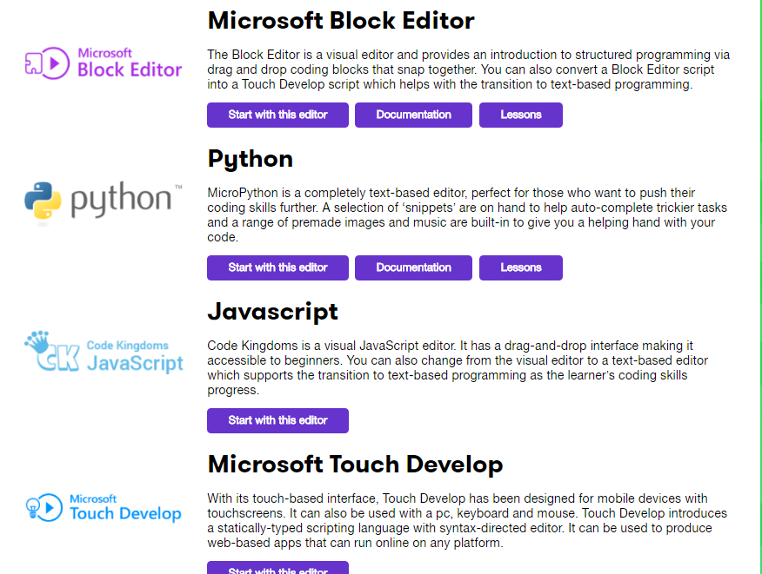
BBC Microbit Code Editor
Website:
microbit.org/code/
Documentation:
microbit-micropython.readthedocs.io

Slide 7
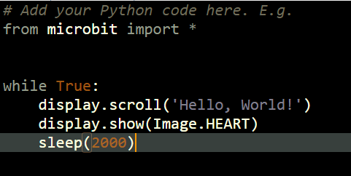
Default

Slide 8
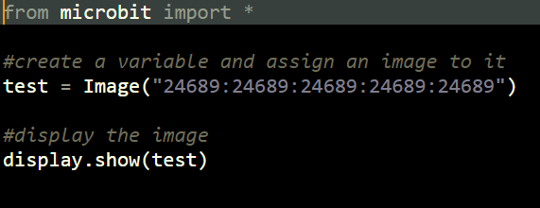
Display

Slide 9
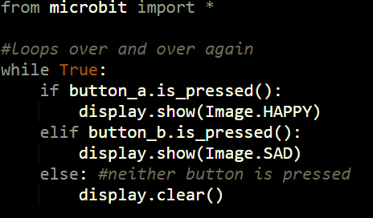

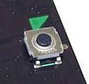
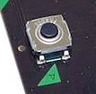

Buttons
Supplementary task : Display a different image when both buttons are pressed at the same time.

Slide 10
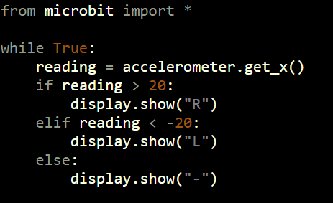
Accelerometer
Supplementary task: Can you display the y-axis reading as well?

Slide 11
Sweet Quizzes and breaks!!!
Go to
Kahoot.it
For amazing quizzes!

Slide 12
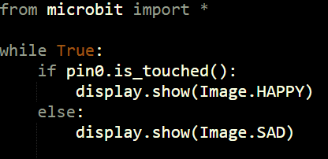
Input/Output

Slide 13
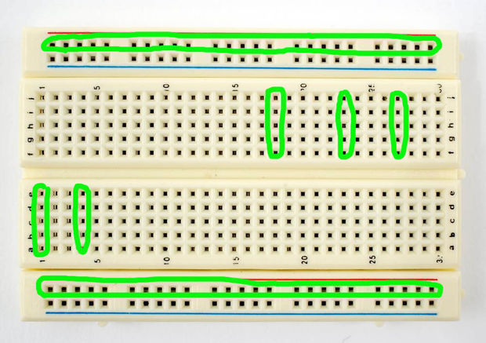

Slide 14
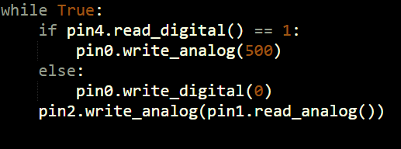
Buzzer, Led, Button and LDR (Setup 1)
88
The LED flickers when the LDR is covered, and the
buzzer sounds when the button is pressed.
Supplementary task: Make the LED turn off completely when the LDR is not covered.

Slide 15
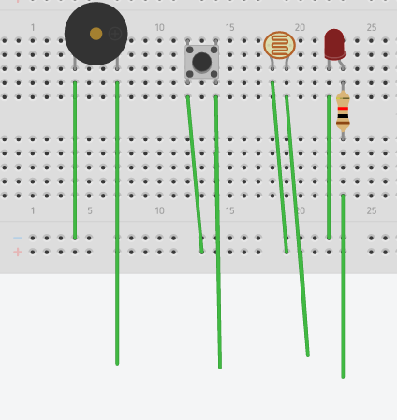
Buzzer, Led, Button and LDR (Setup 1)
Assemble setup 1 as shown in the schematic.
Pin 0 - Buzzer
Pin 1 - LDR
Pin 2 - LED
Pin 8 - Button
With this setup, you can attempt
extra tasks 4, 5 and 6.
-
+
Pin 0
Pin 8
Pin 1
Pin 2

Slide 16
Buzzer/LEDs/Buttons (Setup 2)
Assemble setup 1 as shown in the schematic.
Pin 12, Pin 2, Pin 16 - LED
Pin 0, Pin 1, Pin 8 - Button
Pin 3 - Buzzer
With this setup, you can attempt
extra tasks 7 and 8.
(Follow the schematic on the following slide.)

Slide 17
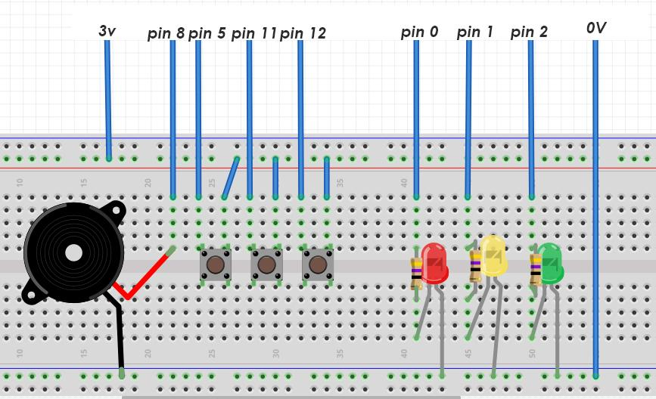
Buzzer/LEDs/Buttons (Setup 2)
Pin3 Pin0 Pin1 Pin8 Pin12 Pin2 Pin16 0V

Slide 18
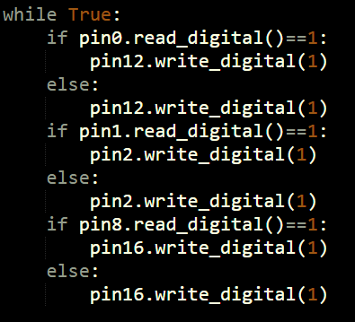
Buzzer/LEDs/Buttons (Setup 2)

Slide 19
Motor and Potentiometer (Setup 3)
(Follow the schematic on the next slide.)
Connect the motor to the terminal connector. The black (negative) end should be connected to the left leg of the transistor. The red (positive) end should be connected to the 3v power supply.
Connect the middle leg of the transistor to pin 0 through the 2.2kΩ resistor. The right leg of the transistor should be connected to the ground (0V)
Connect the left leg of the potentiometer to the 0v pin, the right leg to the 3v power supply and the middle leg of the potentiometer to pin 1.

Slide 20
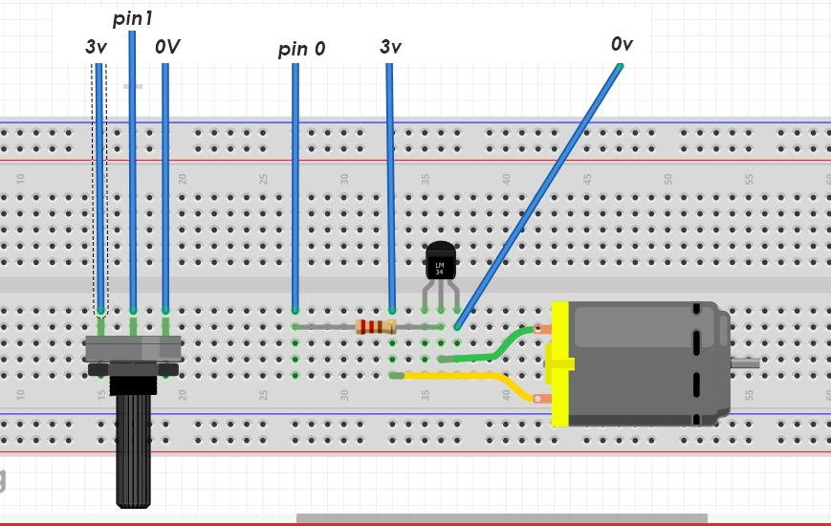
Motor and Potentiometer (Setup 3)

Slide 21
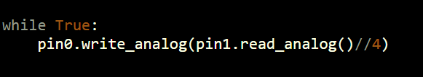
Motor and Potentiometer (Setup 3)
Turning the potentiometer will control the speed of the motor’s rotation.

Slide 22
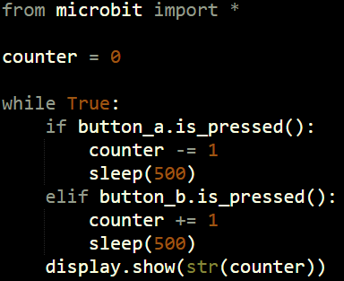
Extra Task 1:
Create a counter that starts at 0. When button B is pressed, the number on the display is increased by 1. When button A is pressed, the counter is decreased by 1. What happens when the counter becomes negative? Can the microbit show two digit numbers?

Slide 23
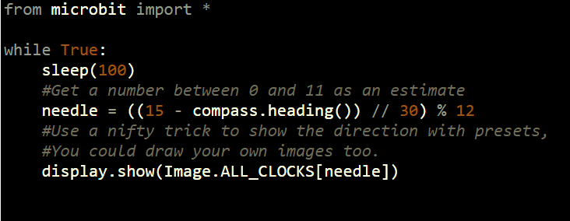
Extra Task 2:
Use the compass to tell where North is. Note: you may have to calibrate the compass first.

Slide 24
Extra Task 3
Create a game with the player being represented by a single bright light on the board(9). The player can move around using the buttons or accelerometer. Create enemies as dim lights (2) and have them move towards the player. The game is over if the player touches the enemies.
Notes:
from microbit import *
import random
def render(play, grid):
read = accelerometer.get_x()
if read > 200 and play <4:
play += 1
elif read < -200 and play >0:
play -= 1
image = ""
for i in range(4):
image += ''.join(grid[i]) + ":"
player = ["0","0","0","0","0"]
player[play] = "9"
image += ''.join(player)
img = Image(image)
display.show(img)
sleep(150)
return play
display.show("A")
while True:
if button_a.is_pressed():
score = 0
grid = [["0","0","0","0","0"] for i in range(4)]
play = 2
while True:
if button_b.is_pressed():
display.show("A")
break
if grid[3][play]=="4":
message = "SCORE:" + str(score//10)
display.scroll(message)
break
en = random.randint(0,4)
grid[3], grid[2], grid[1] = grid[2], grid[1], grid[0]
grid[0] = ["0","0","0","0","0"]
if random.randint(0,3) != 0:
grid[0][en] = "4"
play = render(play, grid)
play = render(play, grid)
score+=1

Slide 25
Extra Task 4 (Setup 1)
This task requires a buzzer, and one button.
Program the microbit to act as doorbell; when the button is pressed, the buzzer should ring for a certain amount of time. Can you program a way to prevent spamming of the doorbell?

Slide 26
Extra Task 5 (Setup 1)
This task requires 1 LDR, a buzzer, and one LED. One or more buttons can also be used.
Program the microbit to act as a security device. When the LDR is blocked, the buzzer should sound and the LED should flash, alerting the user of a potential intruder. Can you program a way to switch off the alarm by pressing the buttons in a certain sequence?

Slide 27
Extra Task 6 (Setup 1)
This task requires a buzzer, and few buttons.
Program the microbit to act as a piano, playing different frequencies when different buttons are pressed. What about playing different frequencies based on how the microbit is tilted?

Slide 28
Extra Task 7 (Setup 2)
This task requires 3 LEDs and a buzzer, and at least one button.
Program the microbit to act as a traffic light, with the light switching from green, to yellow, then red. If the button (pedestrian crossing) has not been pressed, the light quickly changes from red back to green, but if it has been pressed, the traffic light remains red for the pedestrians to cross. The buzzer will sound while pedestrians are allowed to cross.

Slide 29
Extra Task 8 (Setup 2)
This task uses 3 LEDs and 3 Buttons.
Program a simple Simon game, and display the player’s score on microbit. Use the buzzer for additional effect.
Notes:
from microbit import *
from random import randint
arr = []
def read():
if pin0.read_digital()==1:
return 0
elif pin12.read_digital()==1:
return 1
elif pin16.read_digital()==1:
return 2
else:
return 3
def show(x):
if x == 0:
pin1.write_digital(1)
elif x == 1:
pin8.write_digital(1)
elif x == 2:
pin2.write_digital(1)
sleep(500)
pin1.write_digital(0)
pin8.write_digital(0)
pin2.write_digital(0)
sleep(500)
failed = False
while not failed:
arr.append(randint(0,2))
for i in arr:
show(i)
for i in arr:
cin = 3
while cin== 3:
cin = read()
show(cin)
sleep(100)
if cin != i:
failed = True
pin3.write_analog(500)
display.show(str(len(arr)))
break
sleep(2000)

Slide 30
Extra Task 9 (Setup 3)
This task uses the motor and fan.
Use the accelerometer, compass or light dependant resistor to control the speed of rotation of the fan.

Slide 31
Need more extra tasks?
http://www.multiwingspan.co.uk/micro.php

Slide 32
One more thing...
What if you do not have a micro:bit?
https://groklearning.com/

Slide 33
T H A N K
Y O U
- .... .- -. -.-
-.-- --- ..-

Slide 34
How to Contact Us:
Gi Soong Chee: gi.soongchee@dhs.sg
Wang Siyin: wang.siyin@dhs.sg
Wee He-kun: wee.hekun@dhs.sg

